Slide 1
PowerShell Help DeepDive
It's about content!

Slide 2

About the Presenter
June Blender (@juneb_get_help)
SAPIEN Technologies, Inc. : Technology Evangelist
Microsoft Corporation: Senior Programming Writer (1997 - 2014)
Honorary Scripting Guy
PowerShell Hero 2014

Slide 3
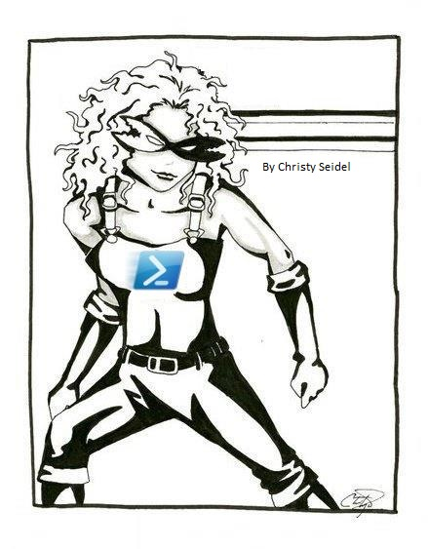
About the Presenter
June Blender (@juneb_get_help)
SAPIEN Technologies, Inc. : Technology Evangelist
Microsoft Corporation: Senior Programming Writer (1997 - 2014)
Honorary Scripting Guy
PowerShell Hero 2014

Slide 4
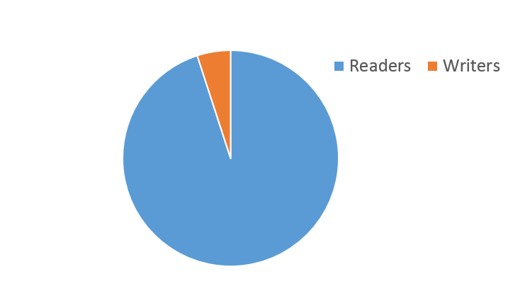
Improving Help: It's about content

Slide 5
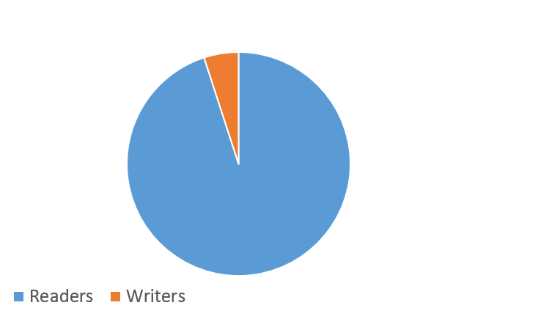
What We Will Cover
Mechanics of writing help
10% Help Mechanics
Help for Command Types
Comment-Based Help
Updatable Help
Auto-Generated Help
90% Help Content
Who should write help?
What should be in it?
What makes great help?
Help for Classes, DSC
Writing great help content

Slide 6
Windows PowerShell Help Formats
 | XML Help | Comment-Based Help
CIM Commands | x
Cmdlets | x
Functions | x | x
Providers | x
Scripts |  | x
Workflows | x | x (4.0+)

Slide 7
Comment-Based Help Costs / Benefits
Easy
Help always matches code
Not supported for cmdlets, providers, CIM commands
No updatable help
One language
FRAGILE !

Slide 8
XML Help Costs / Benefits
Updatable Help
Multiple Languages
Robust; error-safe
Separates help from code (Github)
PSMAML Schema: $pshome\Schemas\PSMaml
Help might not match code

Slide 9
Hedge your bets? Try both? : Precedence
Comment-based help takes precedence over XML help
.ExternalHelp keyword takes precedence over comment-based help
Error in comment-based help
Manifest modules: XML, Autogenerated help
Script modules: Autogenerated help
Error in XML help
Autogenerated help
Notes:
What if you hedge your bets and use both.
In a script module with correctly-formatted .EXTERNALHELP, an error in comment-based help -> autogenerated help

Slide 10
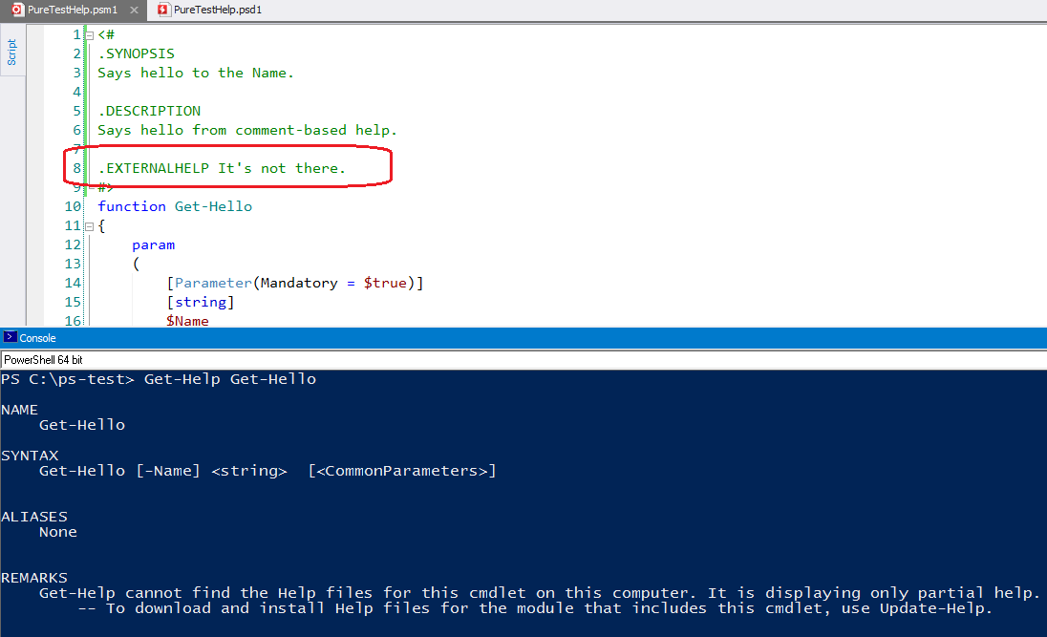
Comment-based help is not a fallback strategy for any
module type.

Slide 11
.ExternalHelp keyword
Associates a function with an XML help file
<#
.ExternalHelp <filename>-help.xml
#>
function MyFunction {}
3.0: Required for functions
4.0: Required for script modules Optional in manifest modules (value ignored)

Slide 12
Comment-based help is fragile
Syntax error in any keyword → all keywords ignored
Failure fallback:
Manifest modules: XML Help, Autogenerated help
Script modules: Autogenerated help (even if you have XML Help)

Slide 13
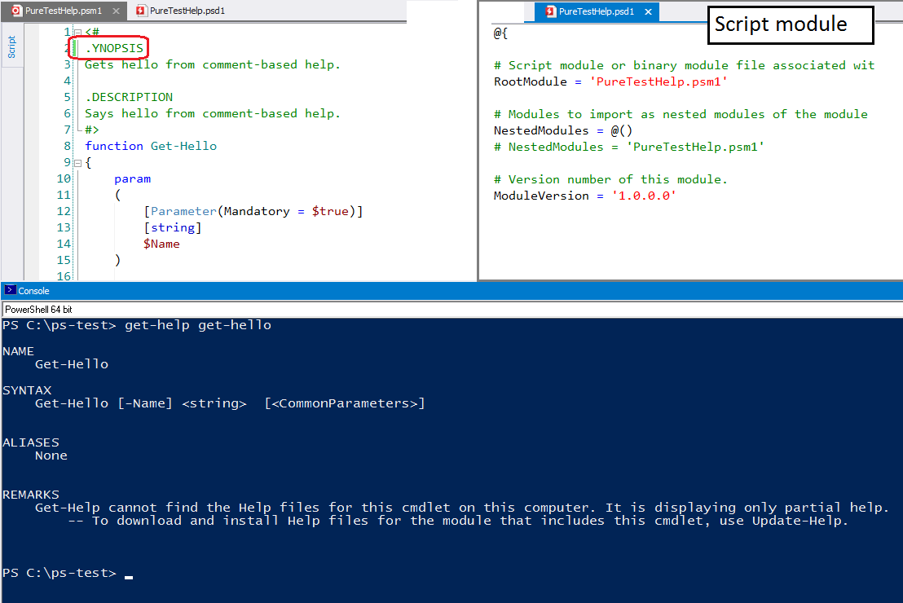
Notes:
In a script module, any error -> autogenerated help, even if there is XML help for the module.

Slide 14
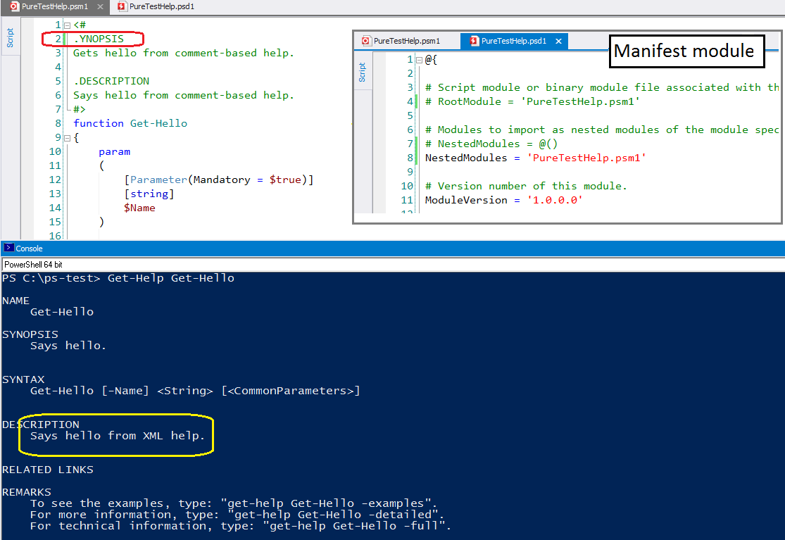
Notes:
In a manifest module, the default is XML help.

Slide 15
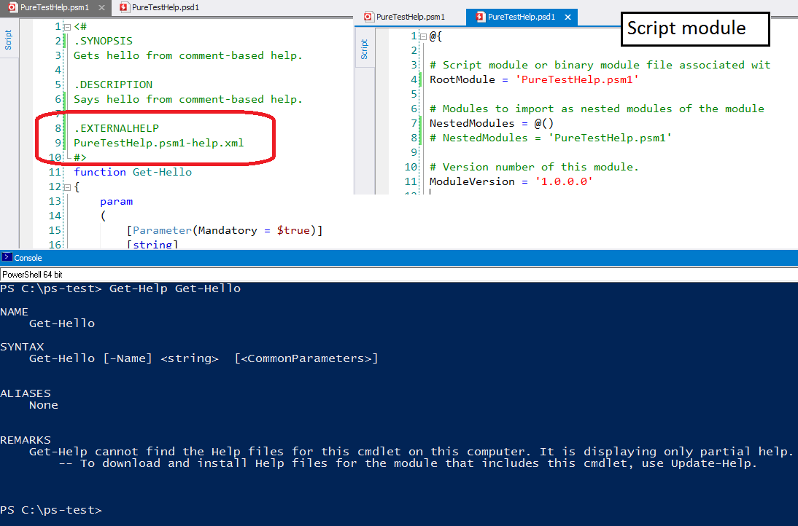
Notes:
.EXTERNALHelp takes precedence over comment-based help ... unless there's an error.
Any error in script module -> autogenerated help, even when there's comment-based help.

Slide 16
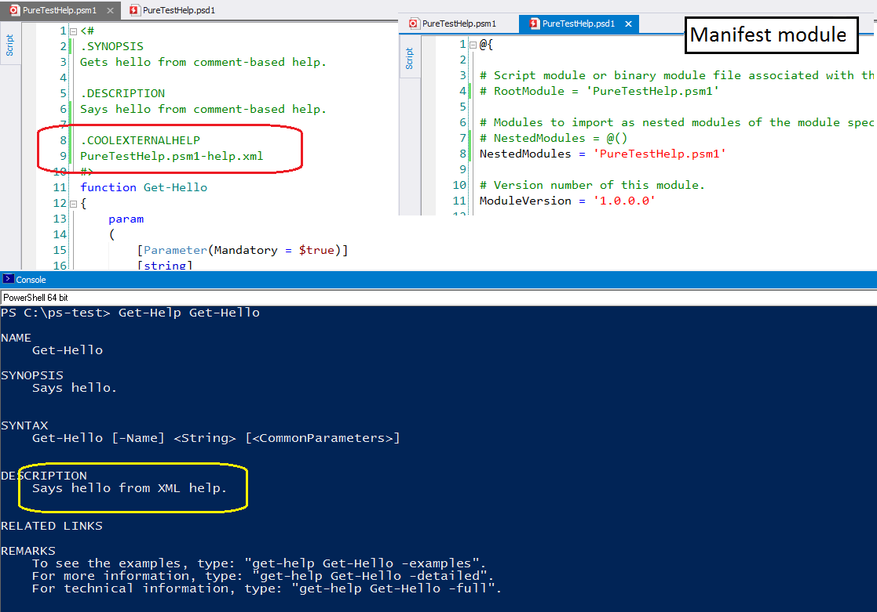
Notes:
Any error defaults to XML help.

Slide 17
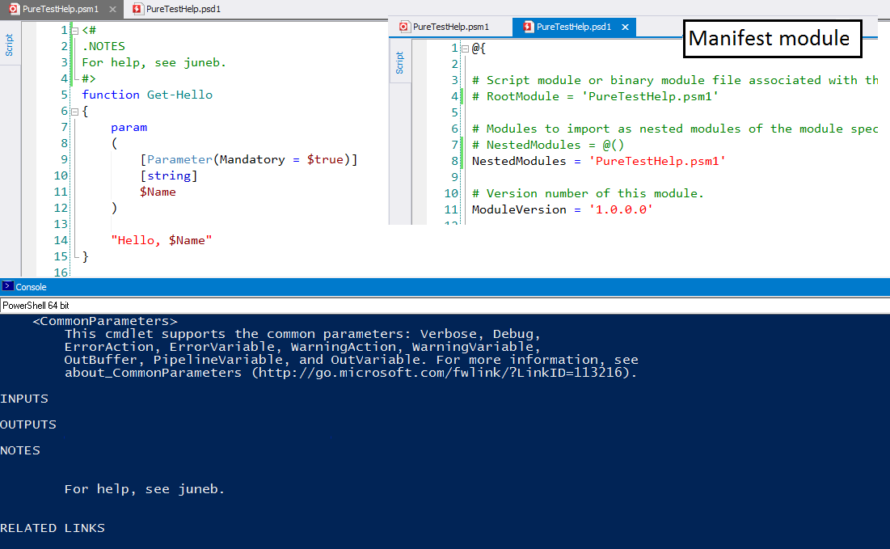
Notes:
Even in a manifest module, comment-based help takes precedence, so use .EXTERNALHELP

Slide 18
Comment-based help keywords
Value on same line:
Parameter <Name>
ForwardHelpTargetName <TopicName>
ForwardHelpCategory <Category>
ExternalHelp <FileName>
Link
Can repeat keyword:
Parameter
Example
Link
Notes

Slide 19
Comment-based help ForwardHelpTargetName
Redirects to a different help topic
# ForwardHelpTargetName <HelpTopic>
# ForwardHelpCategory <Category>
Redirects only to command help (cmdlets, functions)
Does not work with about topics or aliases (regardless of the value of ForwardHelpCategory)
Works only with commands in the session
ForwardHelpCategory is effective

Slide 20
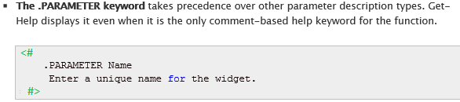
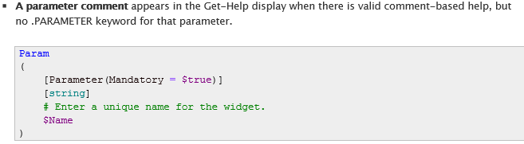
Parameter Help v. HelpMessage v. HelpComment
Comment-based help

Slide 21
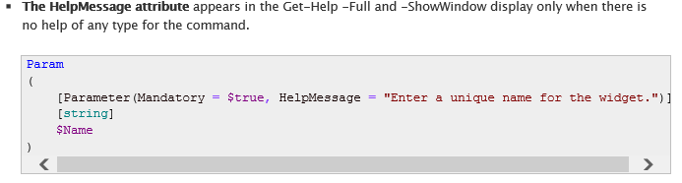
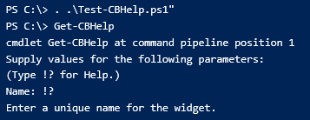
Parameter Help v. HelpMessage v. HelpComment
Auto-generated help
Mandatory parameter prompt + '!?'

Slide 22
XML File Location
Module directory (ModuleBase)
(Get-Module <Module>).ModuleBase
Language-specific subdirectory
(Get-Module <Module>).ModuleBase \de-DE \en-US \es-ES \sv-fi

Slide 23
XML File Name Requirements
 | PS 3.0 | PS 4.0
Cmdlets | <Name>.dll-help.xml | <Name>.dll-help.xml <Module>-help.xml
Providers | <Name>.dll-help.xml | <Name>.dll-help.xml <Module>-help.xml
Functions | Any (.ExternalHelp) | Any (.ExternalHelp for script modules)
Workflows | Any | Any (.ExternalHelp for script modules)
CIM Commands | <Name>.cdxml-help.xml | <Name>.cdxml-help.xml <Module>-help.xml

Slide 24
Encoding XML
UTF8

Slide 25
Parameters in Help
Get-Help does not display help for parameters that it can't see
Parameters that don't exist
Dynamic parameters (cache time)

Slide 27
Writing Help Content
User perspective
Forget the MVPs
Beginner frame of mind
Find a writer
Find a buddy

Slide 28
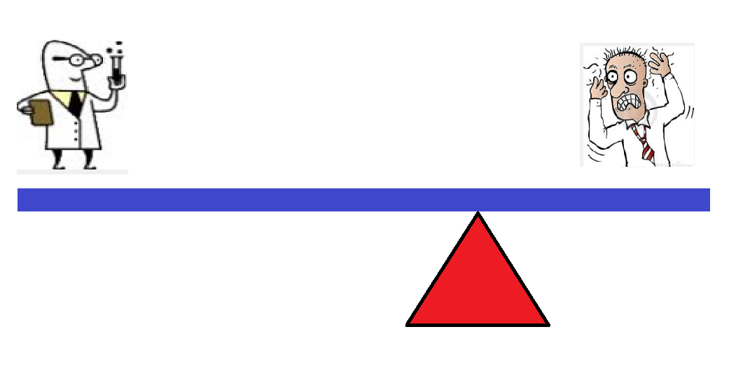
I'm too busy to write help... ... shifting the burden
Inefficient

Slide 29
I'm not good at writing...
Inefficient

Slide 30
I'm not good at writing...
He's worse
Inefficient

Slide 31
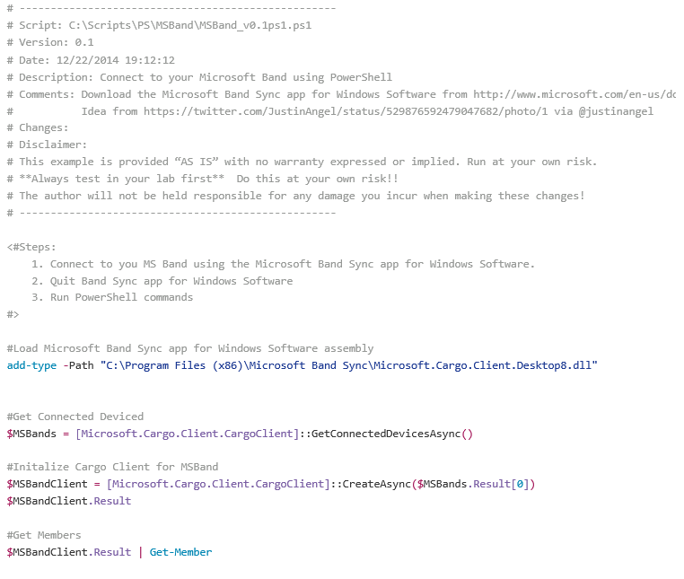

Slide 32
Help v. Code Comments
The difference is the audience.
 | Audience | Content
Help | End-user | Describes the UI
Code comments | Colleagues | Explains the code

Slide 33
Help v. Code Comments
Help maintains the black box.
Help describes the user experience. It does not explain the implementation.
If you must say something about how your command works, write it in Notes.

Slide 34
Writing Help as a specification
Description: Describe the UI.
Examples:
Which parameters you need
Recognizable parameter names
Parameter attributes
Parameter combinations -> parameter sets
Expected outcomes for testing
Inputs: Coordinate types with other cmdlets
Outputs: Define return values
If experience is poor,
rethink the design.

Slide 35
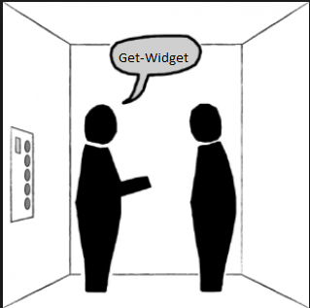
Synopsis: Go/No-Go
Is right tool for the job? (You have 30 seconds.)
It's critical, because users see it first.
Use your Twitter discipline. Make it brief, but don't waste a syllable.
It's not a sales pitch. If it won't work for a user, you want them to know up front.

Slide 36
Synopsis Content:
Identify the technology (What kind of disk?)
Be specific about the action. (Changes property values of offline widgets.)
If it's generic, say so. (Removes all events from the session.)

Slide 37
Evaluate the synopsis
Imagine that you're searching for a solution.
Does the synopsis tell you enough to know whether this might work for you, or should you keep searching?

Slide 38
Improve the Synopsis
Gets the current configuration
Walks the specified upgrade domain.
Sends information to the next resource or fails if there's no resource or if the resource can't be connected.
Name : Get-AzureEnvironment Synopsis : Gets Azure environments
Name : Enable-AzureWebsiteDebug Synopsis : Enables the website's debug

Slide 39
Improve the Synopsis
Poor: Gets the current configuration
Better: Gets the current configuration of the Desired State Configuration (DSC) resource node.
Poor: Walks the specified upgrade domain.
Better: Gets properties of a Windows domain upgraded by using <cmdlet>
Poor: Sends information to the next resource or fails if there's no resource or if the resource can't be connected.
Better: Sends a configuration object to its child resource in the Widget resource tree.

Slide 40
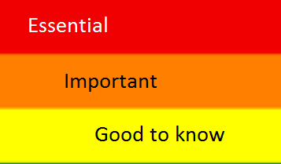
Description
Describes the cmdlet UI.
Explains the intended use.
Calls out important parameters.
Lists requirements (elevated)
Warns of likely errors
Version restrictions
New features

Slide 41
Parameter descriptions
Parameter names help.
Standards make the predictable.
Hide differences
Parameter descriptions include:
Effect on cmdlet behavior
Content/format of valid parameter values
Default behavior

Slide 42
Parameter descriptions
Invoke-AsWorkflow -Expression<String> Runs the specified expression as a workflow. <- Behavior Enter the expression as a string, such as "ipconfig /all". If the expression includes spaces or special characters, enclose the expression in quotation marks. <- Parameter value format

Slide 43
Parameter descriptions
New-AzureResourceGroup -Identity<String>
Gets the gallery template with the specified Identity value. Wildcards are not permitted. You can specify only one Identity in each command.
To find the Identity of a gallery template, run Get-AzureResourceGroupGalleryTemplate without parameters.

Slide 44
Parameter descriptions
Invoke-Command -ComputerName<String[]>
Specifies the computers on which the command runs. The default is the local computer.
When you use the ComputerName parameter, Windows PowerShell creates a temporary connection that is used only to run the specified command and is then closed. If you need a persistent connection, use the Session parameter.
Type the NETBIOS name, IP address, or fully-qualified domain name of one or more computers in a comma-separated list. To specify the local computer, type the computer name, "localhost", or a dot (.).

Slide 45
Examples : The Show in Show & Tell
Instructive: Model or template for other commands
Teach one concept in each example
Use clear, simple language
Get, not "retrieve"
Use, not "utilize"
Change, not "modify"
Don't be clever : Forget the MVPs

Slide 46
Examples: Order of operations
Simple -> Complex
Use only mandatory parameters
Use optional parameters
Show parameter combinations
Real-world example

Slide 47
Examples
Use full parameter names. No cmdlet aliases. No tricks.
Show expected output. (Am I doing this right?)
Try-it-ready: Use resources most users have on the system.
Use each parameter at least once with a realistic parameter value. (How do I format the parameter value?)
Avoid extended one-liners. Show one operation in each step.
Don't be clever : Forget the MVPs

Slide 48
Examples
Teach the object. Use properties that are not in the default display.
If anything in the example is version-specific, say so.
For advanced commands, explain your strategy. Explain why you constructed the command this way. If the command uses expressions, explain them in detail.
Don't be clever : Forget the MVPs

Slide 49
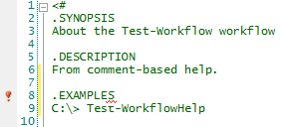
Wish List
Syntax checking in comment-based help
Default value in CommandInfo
Populate HelpFile property
Improve schema files
Improve consistency

Slide 50
About help : for modules
How do I use the cmdlets together?
In what order do I use them?
Is one a prerequisite?
Are any dependent on others?
Is one designed to pipe to another?
How do I use your module to solve a problem

Slide 51
Help for Script Workflows
3.0
Comment-based help is not supported in workflows
Requires XML help with .ExternalHelp keyword / valid value
4.0+
Same as functions
Comment-based help works
Script modules: XML help requires .ExternalHelp / valid value
Manifest modules: ExternalHelp is not required.

Slide 52
Supporting Online Help
Help: URI in first Related Link
...takes precedence over...
Code: HelpUri Attribute

Slide 53
Supporting Online Help
HelpUri Attribute
Cmdlets
[Cmdlet(VerbsCommon.Get, "Widget", HelpUri = "<uri>")]
Functions, Workflows
[CmdletBinding(HelpUri="<uri>")]
Cim Commands
<CmdletMetadata Verb="Get" HelpUri="<uri>"/>

Slide 54
Supporting Online Help
Help: First related link
Comment-based help
<#
.LINK
http://fabrikam.com/getWidget.htm #>
XML Help
<maml:relatedLinks>
<maml:navigationLink>
<maml:linkText>Online Version:</maml:linkText>
<maml:uri>http://fabrikam.com/getWidget.htm</maml:uri>
</maml:navigationLink>
URI only
No link name

Slide 55
Updatable Help
Find an online site
Add HelpInfoUri to module manifest
Generate HelpInfo.xml file
Package help in CAB file (MakeCab.exe)
Upload HelpInfo.xml to HelpInfoUri location
Upload CAB to the HelpContentUri location

Slide 56
Updatable Help: HelpContentUri
HelpInfoUri: Location of the HelpInfoXML file.
HelpContentUri: Location of CAB file.

Slide 57
How to Contact Me
Website: www.sapien.com/blog
E-Mail: juneb@sapien.com
Facebook: facebook.com/juneblender
Twitter: @juneb_get_help
LinkedIn: www.linkedin.com/in/juneblender

Slide 58

Thank You
Please fill out an online session evaluation – they are an important part of making the Summit great!
Recorded sessions are posted on the PowerShell.org YouTube channel. Visit PowerShell.org for more information.

